Slide 1

Stage 1 Are You Course Designer: Ken Wang
Are You is a 24 round, 120 point COMSTOCK LONG course. There are 10 USPSA targets and 4 steel targets. The best two hits per target will score. Steel must fall to score. The start signal is audible.
The Handgun start position is standing with feet touching marks. Handgun is loaded and holstered. The PCC start position is standing with with feet touching marks, PCC loaded, safety on, stock on belt.
On the audible start signal, engage all targets from within the shooting area.

Slide 2
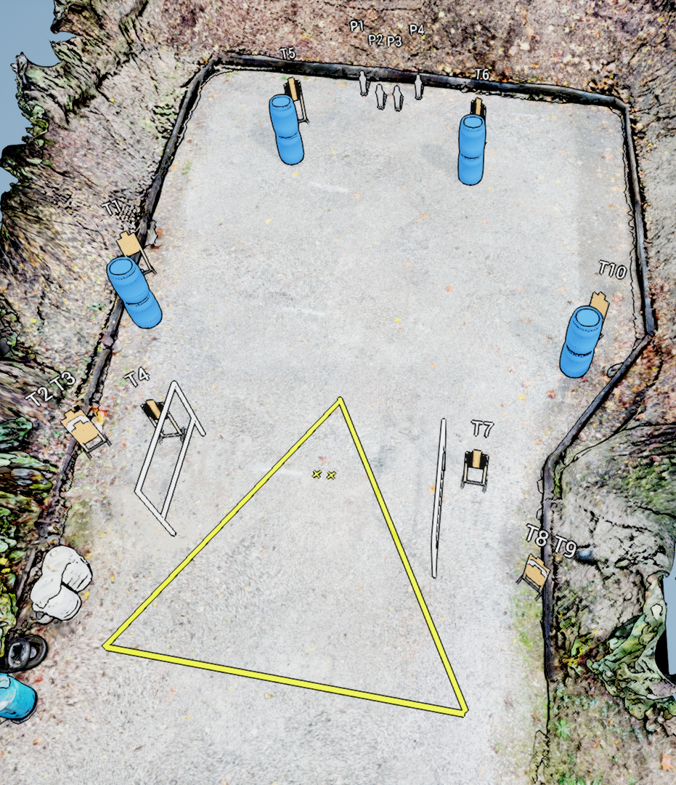
 | Stage 1 Are You Course Designer: Ken Wang

